Slide 1
Overview of Behavioral Health & Substance Abuse
Nicole Wolf, MEd

Slide 2
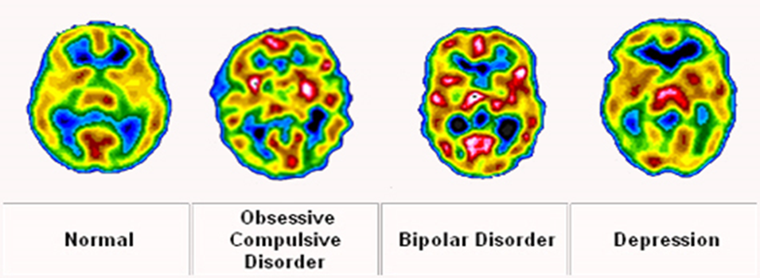
What is behavioral health?
Mental Disorder/Mental Illness
Impacts thinking, emotions and behavior
Disrupts work, daily activities and relationships
One in four individuals can be diagnosed at any given time

Slide 3
U.S. Youth with a Mental Disorder During Adolescence (Age 13-18)
 | Prevalence (%)
Anxiety Disorders | 31.9
Behavior Disorders | 19.1
Mood Disorders | 14.3
Substance Use Disorders | 11.4
Overall Prevalence | 22.2

Slide 4
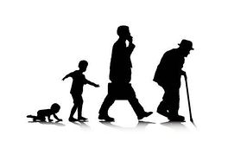
Median Age of Onset
Anxiety Disorders – Age 11
Eating Disorders – Age 15
Substance Use Disorders – Age 20
Schizophrenia – Age 23
Bipolar – Age 25
Depression – Age 32

Slide 5
Adolescent Development

Slide 6
Adolescent Development

Slide 7
Adolescent Development
Physical Changes:
Hormones.
Height and weight.
Mental Changes:
Abstract thinking skills.
Logic and reason in decision making.
Own beliefs.
Questioning authority.
Emotional Changes:
Shifts mood quickly.
More intense feelings.
Risk-taking and Impulsive behavior.
Social Changes:
Experimentation with social and cultural identity.
Peer influence.
Awareness of sexual identity.

Slide 8
Resiliency
Despite all of these challenges, most youth pass through adolescence with relatively little difficulty.

Slide 9
Risk Factors for Mental Illness
Genetic predisposition
Family dynamics
Medical conditions
Brain injuries
Social influences
Environmental influence
Traumatic events

Slide 10
Protective Factors
Good problem solving skills
Feeling of control in their own life
Spirituality
Avoiding substance use
Consistent home routine
Family support
Economic security
Constructive recreation
Feeling close to at least one adult
Regular attendance/school performance

Slide 11
Typical Behaviors vs. Symptoms
Typical Adolescence | Potential Warning Sign
Withdrawing from family to spend more time with friends | Withdrawing from friends, family and social activity
Wanting more privacy | Becoming secretive; need for privacy seems to be hiding something
Moving from childhood likes to teen pursuits | Losing interest in favorite activities and not replacing with other pursuits

Slide 12
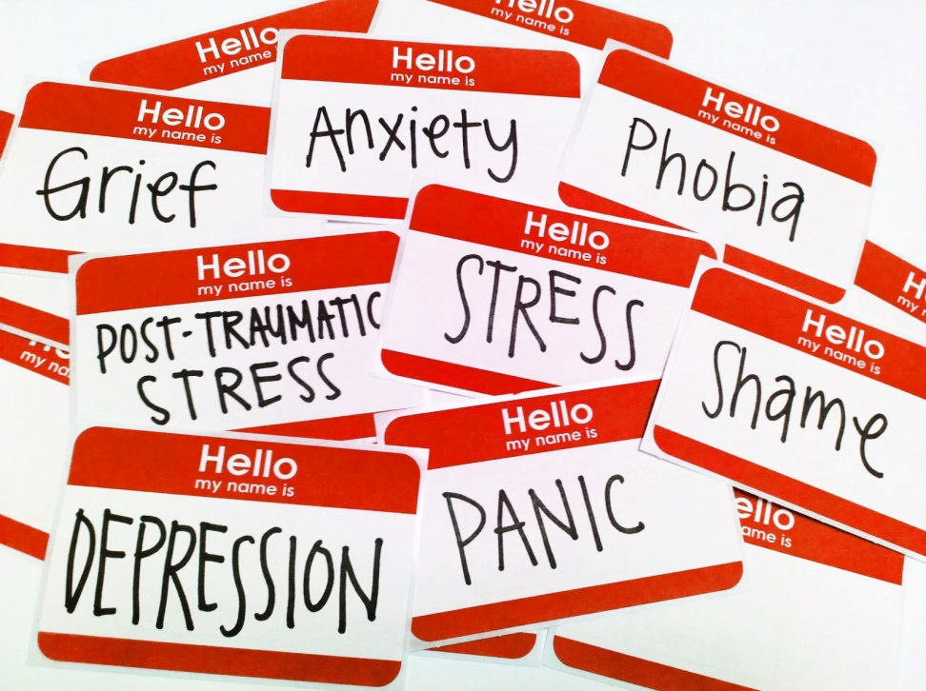
What Are Some of the Disorders You’ve Heard About?
ADD/ADHD/ODD
Anxiety Disorders
Bipolar Disorder
Depression
Eating Disorders
Psychosis
Substance Use Disorders

Slide 13
Signs & Symptoms: Physical
Cardiovascular: pounding heart, chest pain, blushing.
Respiratory: shortness of breath.
Neurological: dizziness, headache, sweating.
Hormonal: irregular menstrual cycle, loss of nocturnal emissions, loss of sexual desire.
Gastrointestinal: dry mouth, stomach pains, nausea, vomiting, diarrhea.
Musculoskeletal: aches and pains, restlessness,, inability to relax.
Pattern adjustments: noticeable changes to sleep or appetite.
Appearance: Change in hygiene, unkempt, weight gain or loss.

Slide 14
Signs & Symptoms: Emotions
Depressed mood and/or mood swings
Unrealistic or excessive anxiety or guilt
Excessive irritability or anger
Lack of inhibition
Lack of emotion or emotional response
Helplessness or hopelessness
Oversensitivity to comments/criticism
Low self-esteem

Slide 15
Signs & Symptoms: Behaviors
Crying spells
Withdrawal from others
Inability to manage responsibilities
Loss of interest in personal appearance
Loss of motivation
Slow movement
Use of drugs and alcohol
Changes in energy level
Obsessive or compulsive behavior
Avoidance or phobic behavior
Showing distress
Talking rapidly
Non-suicidal self injury

Slide 16
Signs & Symptoms: Thoughts
Self-criticism
Pessimism
Rigid thinking
Racing thoughts
Difficulty making decisions, concentrating or remembering.
Altered sense of self
Delusions or hallucinations.
Lack of insight.
Suspiciousness.
Thoughts of death and suicide.
Notes:
Self-blame.
Tendency to believe others see one in a negative light.
Odd ideas.

Slide 17
Substance Abuse
Brain Development
Limbic System
Frontal Lobe
Co-Occurring Disorders
Self Medicating
Accidental Addiction

Slide 18
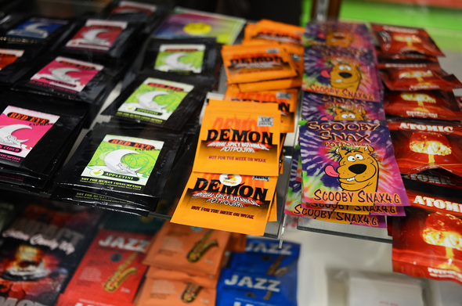
Substances of Use
Tobacco
Alcohol
Drugs
Party Drugs
Pills
Synthetic Drugs
Household Items
Whipped Cream
Markers
Nail Polish
Cough Syrup
Mouthwash
Laxatives
Antihistamines
Diet Pills
Hand Sanitizer
Nutmeg
Vanilla Extract
Energy Drinks

Slide 19
Warning Signs
Physical
Behavioral
Nosebleeds
Frequent Nausea, headaches
Clenching teeth
Excessive thirst “Cottonmouth”
Sudden change in weight
Accidents, bruises
Nodding off
**Can be MH Symptoms**
Mood changes
Loud, obnoxious behavior
Unusually tired
Hostility
Avoiding eye contact
Secretive/locking doors

Slide 20
Warning Signs
Social
Belongings
Loss of interest in…
Schoolwork
Extracurricular activities
Not fulfilling school/work obligations
Complaints from teachers, neighbors, co-workers
Change in relationships with family and/or friends
Money issues
Missing…
Rx or OTC Meds
alcohol/cigarettes
money/valuables
Appearance of…
Unusual containers/wrappers
Seeds
Pipes, papers, other devices
Visine
Unusual smells

Slide 21
What do you do?
Reassure them that they are safe
Be calm and quiet
Be patient—some behaviors are not willful
Be conscious of how their state is impacting you and how you feel
Do not enter into the delusional thinking
Ask them what they are hearing or seeing

Slide 22
Have a conversation…
Ask how the person is feeling.
Describe what you’ve seen.
Express any concerns.
Don’t initially focus on changing the person’s behavior, perspective or symptom.
Use “I” statements that are not accusatory.
Information vs. Advice

Slide 23
Professional Interventions
Example of professionals
Doctors (primary care physicians); Psychiatrists
Social workers, counselors, psychologists, and other mental health professionals
Examples of Professional Help
“Talk” therapies
Medication
Psychoeducation
Access to Care
Insurance
MA Loophole

Slide 24
Medication
Rarely the sole treatment option
Discussions should include the family and the healthcare provider
Trial dosing and frequent monitoring are critical
“Off label” because research is limited
Side effects
Black box warning

Slide 25
Other Types of Support
Peer support groups
Family, friends, and faith/other social networks
Family support groups
Exercise and nutrition
Discontinuation of alcohol and other drugs

Slide 26
What if the Person or Family doesn’t want help?
Find out Why
Fear of embarrassment
Shame
Identify Resources
Intervene in an Emergency

Slide 27
Thank You for Being here!
To learn more…
Mental Health First Aid
Tuesday May 16th - Tomorrow – seats available
Thursday June 29th
Youth Mental Health First Aid
Thursday July 27th
Thursday August 10th
No cost to you and lunch included
Held at Lenape Valley Foundation
To Register
Lenapevf.org → Education & Training → Mental Health First Aid

